Slide 1

Service quality ai-based system
Supervised by:
Dr/ ahmed salah
Ta/ Moataz Mohamed

Slide 2

Team members:
Ziad elsayed
Amr ayman
Ali fathy
Ahmed Samir
Yousef Mohamed
Mostafa gamal

Slide 3
Agenda
Time plane (Gantt chart)
Tools
References
Introduction
Background
Motivation
Related work & Application
Objectives
Datasets
System Architecture
Phases Description

Slide 4

Introduction

Slide 5
Introduction
سلام عليكم انا كنت انهردا في السجل المدنى و للأسف بواجه مشكلة انى بقف في الزحمة كتير و الدنيا بتبقا صعبة ياريت تشوفولنا حل للمشكلة ديه
Model Pipeline
Processing Data
Recommend Action : مساء الخير عزيزى المواطن شكرا لتعليقكم برجاء التوجه الى ماكينة الصراف الالى و هناك يمكنك استخراج جميع اوراقك بدون الانتظار
Topic: السجل المدني والجوازات
Sentiment: negative

Slide 6

Introduction(cont.)
Service quality is one key element
for smart government digital
transformation to enhance
the quality of governmental services
by gathering citizens’ reviews, complaints
and feedbacks on different
governmental sections.

Slide 7
Background

Slide 8
Background
In different governmental sections they need to take reviews from citizens to measure the quality of services of all affiliated institutions.

Slide 9
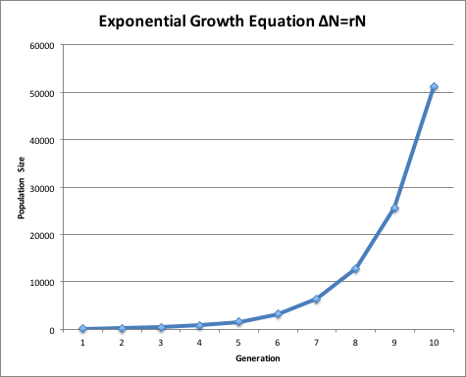
Background(cont.)
The faced problems in this process are :
The huge amount of citizens’ reviews according to the vastly increase in population.
the large effort needed to analyze that amount of reviews.
The wasted money on increasing employees working on reviews.

Slide 10
Background(cont.)
The proposed solutions are:
providing fully automated system to do the operation of analyzing reviews.
automatic directing of the reviews to the target destination.

Slide 11
Motivation

Slide 12

motivation
enhance the connection between
the government and the people.

Slide 13

Motivation(Cont.)
2) Helping governmental employees by facilitating
operations done on complaints and feedbacks.
3) Speeding up the process of reviewing complaints and feedbacks.

Slide 14

Motivation(Cont.)
4) Improving the flow of the information form citizens to governments, governments to citizens, and within
government itself.
5) Improving governmental services’ quality according to reviews ,complaints and feedbacks.

Slide 15
Related work & Application

Slide 16
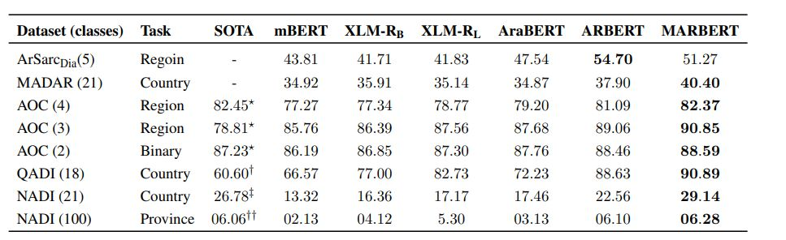
Related works and applications
the opposite figure refer to the F1-scores of the topic classification models

Slide 17
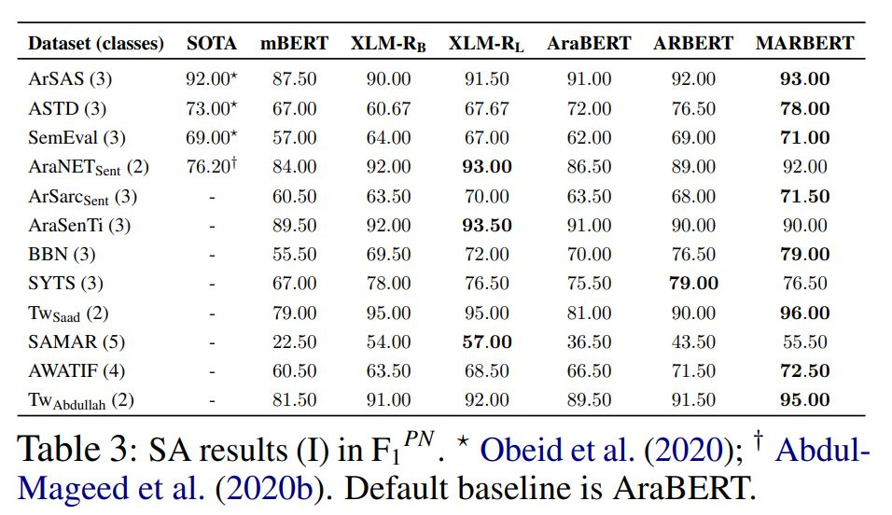
Related works and applications(Cont.)
the opposite figure refer to the F1-scores of the sentiment analysis models

Slide 18
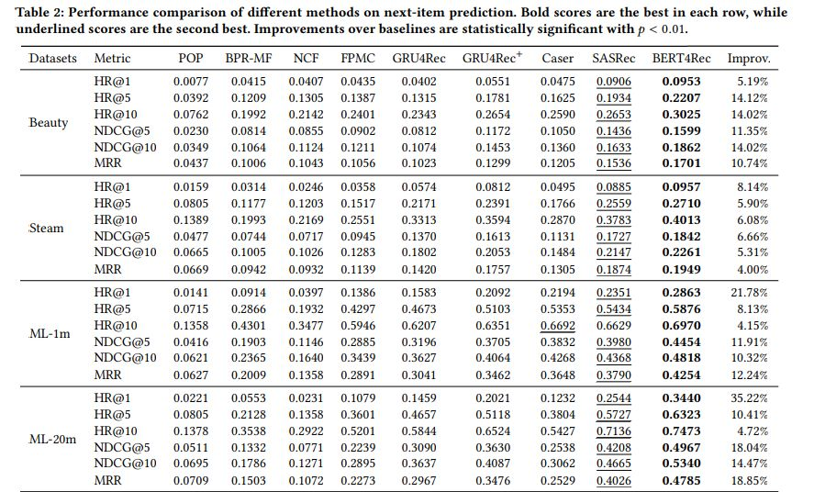
Related works and applications(Cont.)
the opposite figure refers to different metrics of recommend system models

Slide 19
objectives

Slide 20
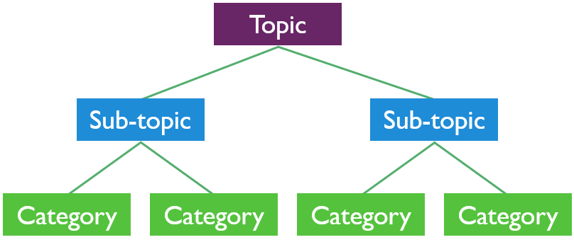
objectives
Topics discovery:
getting topics from the text and classify them to the specified categories to know the main purpose and the targeted section from the feedback.

Slide 21
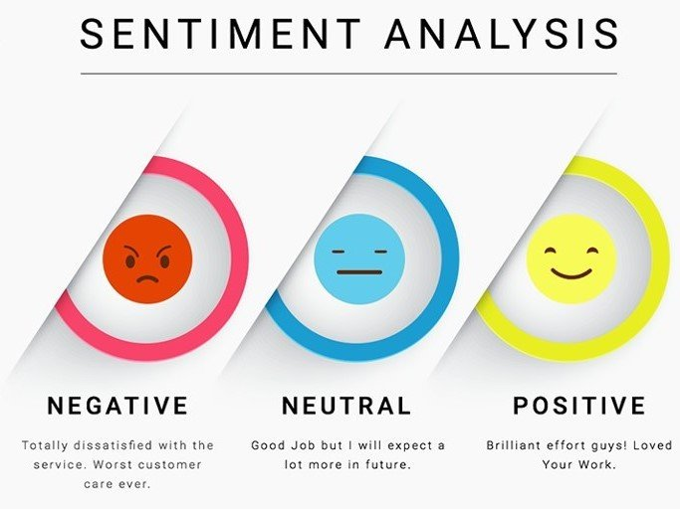
Objectives(cont.)
Sentiment analysis:
Classifying the text into negative, positive and neutral to make it easy to know the good and bad opinions.

Slide 22
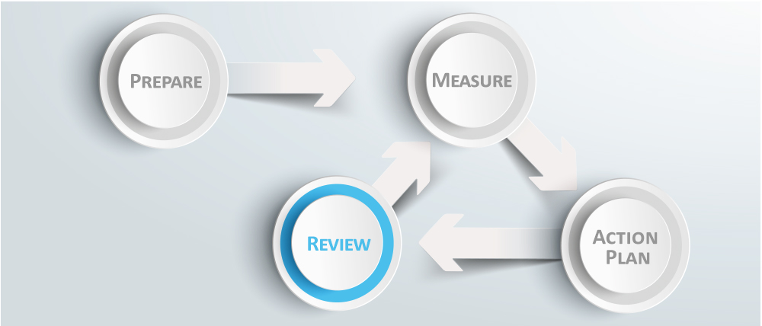
Objectives(cont.)
Recommend actions:
Redirecting the reviewed text to similar issues then recommend action related to this group of similar issues.

Slide 23
DataSets

Slide 24
Datasets
We have processed different Arabic datasets like:
Company reviews dataset
Brad Arabic dataset
Ultimate news dataset
And others
The best of all datasets was Glare dataset which was provided by dell technologies AI-use cases.

Slide 25
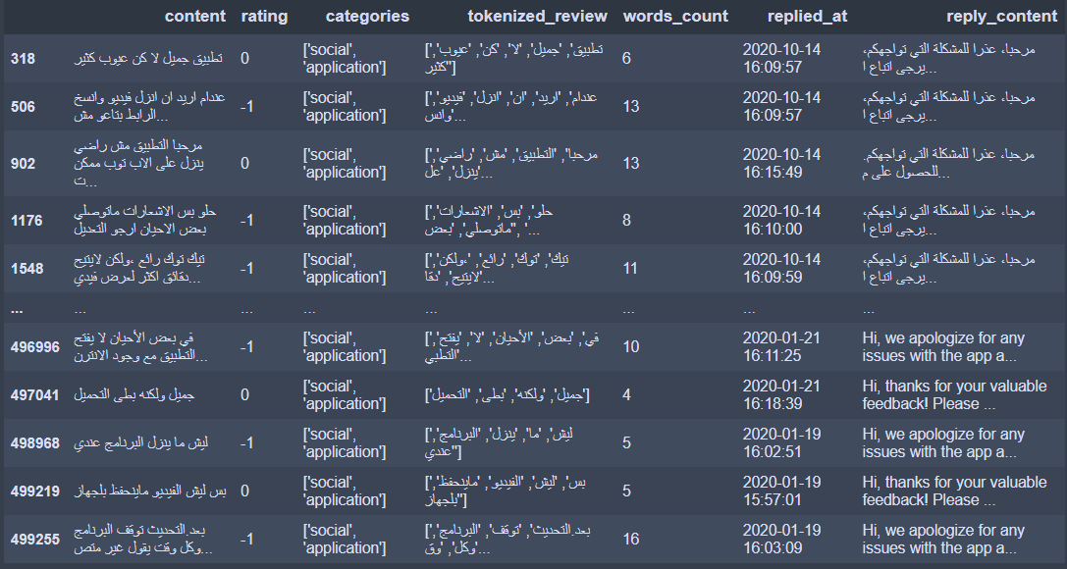
Datasets(cont.)
The opposite figure refers to the last form of Glare dataset after processed.

Slide 26
System architecture

Slide 27
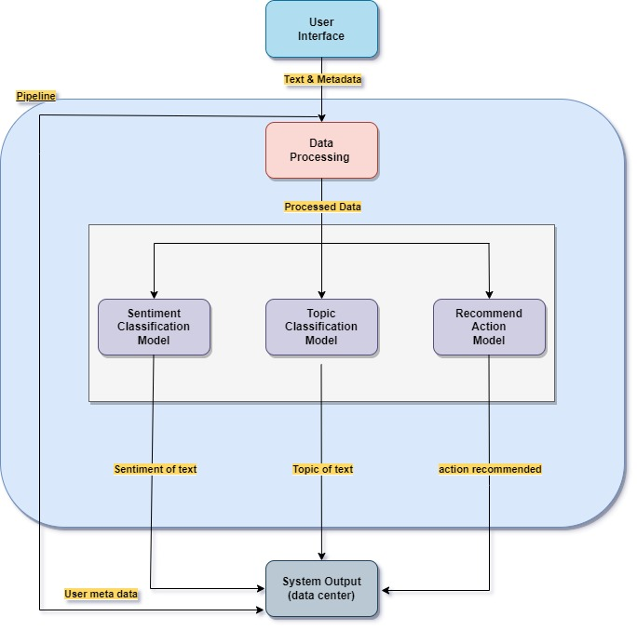
System architecture

Slide 28
Phases description

Slide 29
Phases description
user interface
user provides his review and meta data through the application then they are sent to the system pipeline.

Slide 30
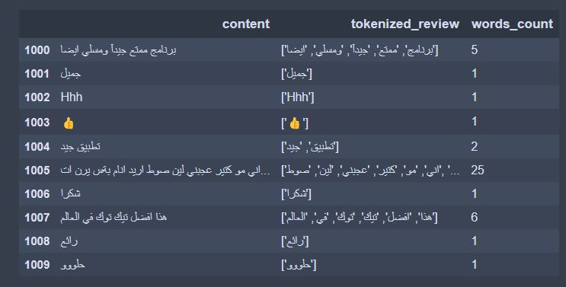
Phases description(cont.)
2) System pipeline
Data pre-processing
the model takes the text and pre-processes it to the shape that the model work on.

Slide 31
Phases description(cont.)
2) system pipeline
2. Pre-Trained models
the pre-trained models are used to get the topic, sentiment type and recommended actions if there.

Slide 32
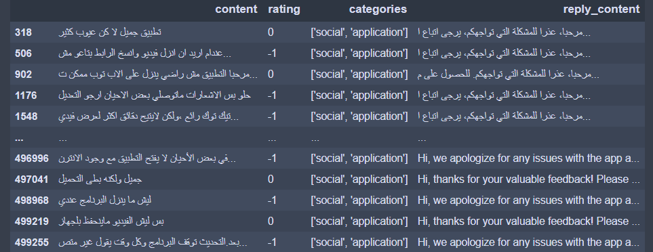
Phases description(cont.)
3) System output
the output of the system pipeline(sentiment type , topic, recommended action) is collected with the user meta data and stored in data center of specific organization.

Slide 33
Time plan

Slide 34
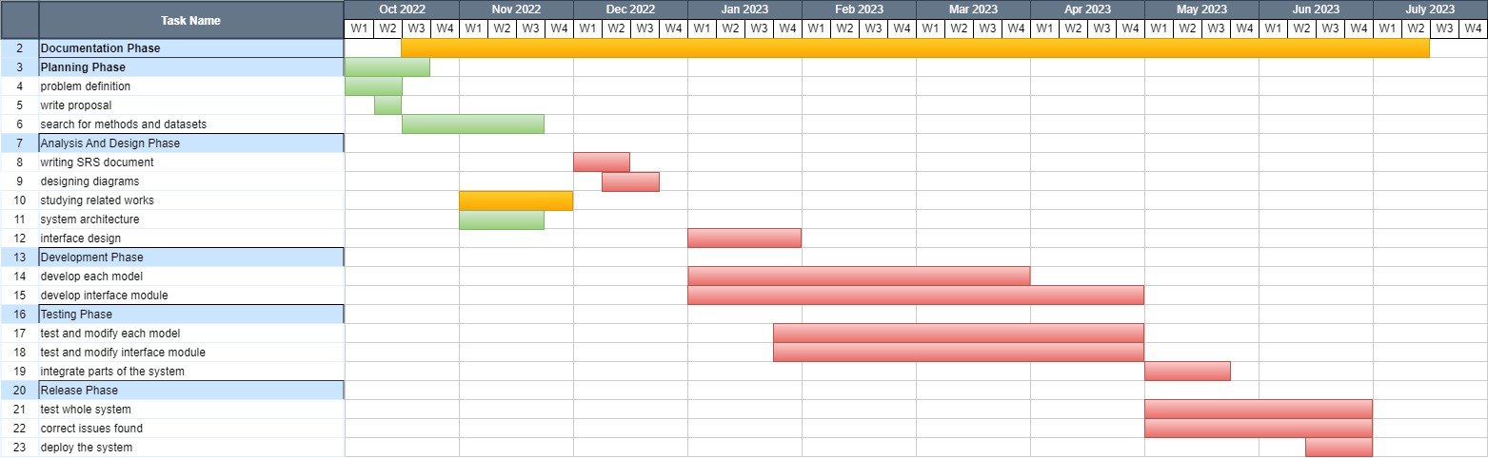
Gantt-chart

Slide 35

Slide title 29
Tools

Slide 36






tools
Python language
Docker
Pycharm IDE
Jupyter ide
Visual studio code ide
Google colab

Slide 37
references

Slide 38
references
1: Convolutional Neural Networks for Sentence Classification Yoon Kim New York University yhk255@nyu.edu 3 Sep 2014Link: 1408.5882v2.pdf (arxiv.org)
2: Jeremy Howard∗ fast.ai University of San Francisco j@fast.ai 23 May 2018Link: 1801.06146v5.pdf (arxiv.org)
3: MULTILEVEL SENTIMENT ANALYSIS IN ARABIC, 1 st Ahmed Nassar Faculty of Information Technology Islamic university of Gaza Gaza, PalestineLink: Paper Title (use style: paper title) (arxiv.org)

Slide 39
references
4: Omar Alharbi, Comparative Study of Feature Selection Methods for Dialectal Arabic Sentiment Classification Using Support Vector Machine,2019.Link: https://paperswithcode.com/paper/labr-a-large-scale-arabic-sentiment-analysis
5: Mixing Dirichlet Topic Models and Word Embeddings to Make lda2vec Christopher Moody Stitch Fix One Montgomery Tower, Suite 1200 San Francisco, California 94104, USA,2016Link: https://paperswithcode.com/paper/mixing-dirichlet-topic-models-and-word
6: ARBERT & MARBERT: Deep Bidirectional Transformers for ArabicMuhammad Abdul-Mageed AbdelRahim Elmadany El Moatez Billah Nagoudi†Natural Language Processing LabThe University of British Columbia{muhammad.mageed,a.elmadany,moatez.nagoudi}@ubc.ca

Slide 40

Thank you

